Slide 1

HPML Group 11/01/2023
Deep Learning
CNNs
Bryan Cardenas
Thomas van Osch
Vivian van Oijen

Slide 2

How do Computers see?

Slide 3
How do Humans see?

Slide 4
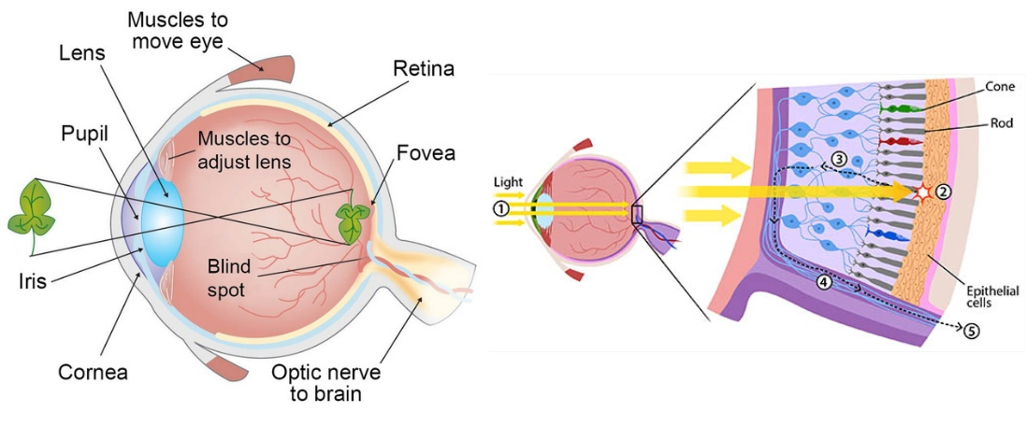
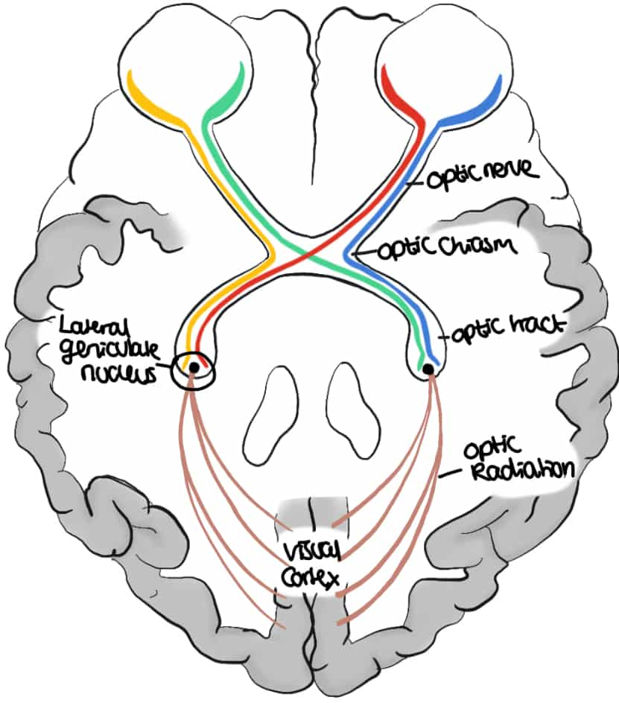
Mammalian Visual System

Slide 5
Mammalian Visual System
Cones and rods picks up photons and propagate the signal to the back of our brain
Along the way, the signal gets processed in stages

Slide 6
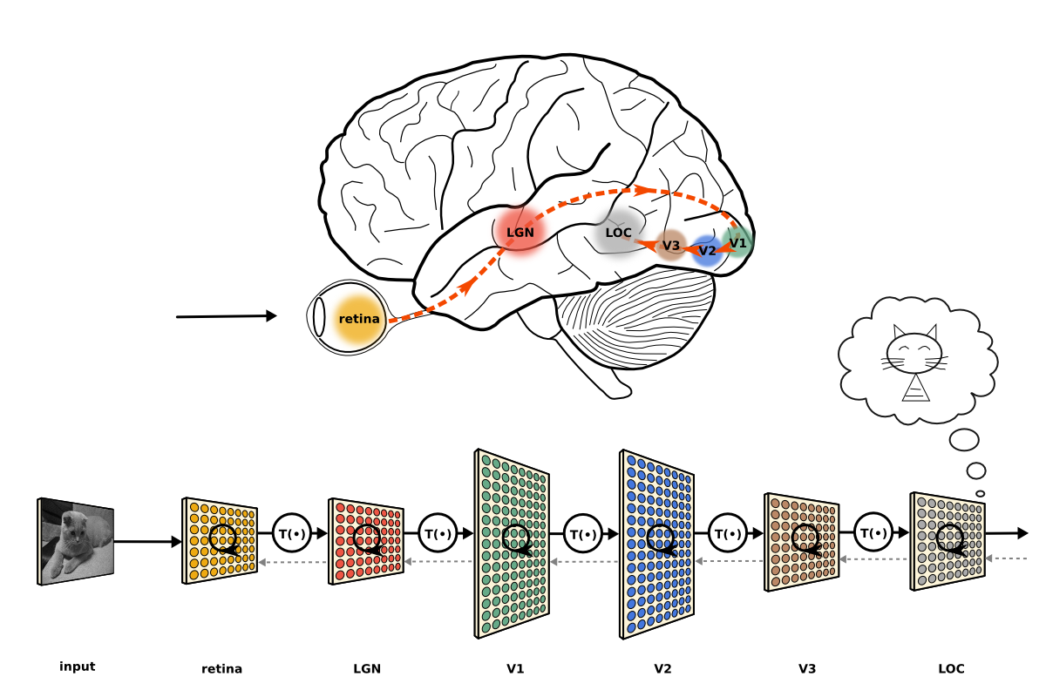
Mammalian Visual System
Cones and rods picks up photons and propagate the signal to the back of our brain
Along the way, the signal gets processed in stages
The extracted information gets aggregated and formed into an image

Slide 7
Mammalian Visual System
Cones and rods picks up photons and propagate the signal to the back of our brain
Along the way, the signal gets processed in stages
The extracted information gets aggregated and formed into an image

Slide 8
11/01/2023
Convolutional
Neural Networks
High Performance Machine Learning Group

Slide 9
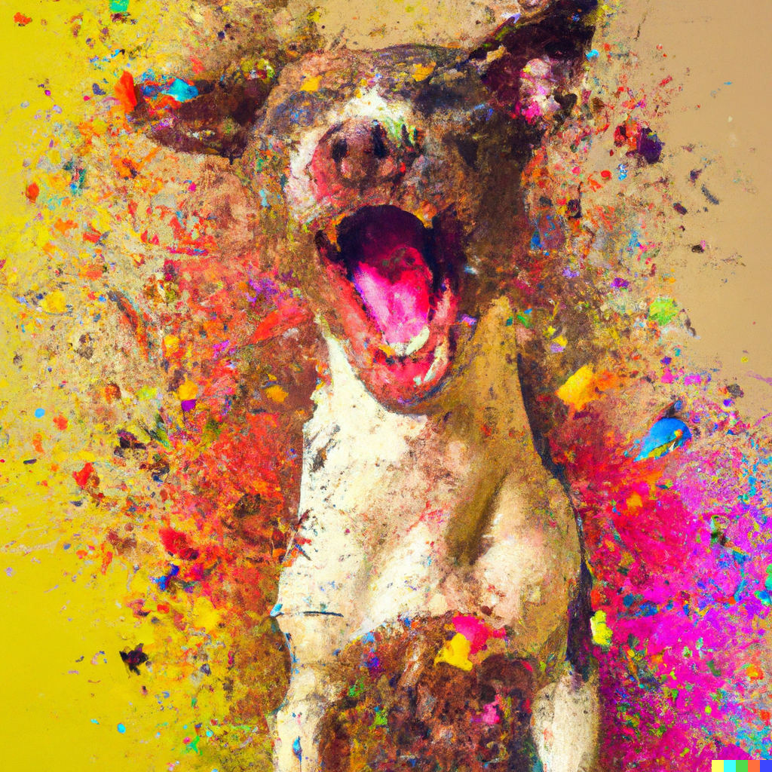


Image Representation
Is a matrix or grid of intensity values
integers [0, 255] or float points [0,1]
Each element in the matrix is a pixel
Can have 1 greyscale channel or multiple colour channels: RGB

Slide 10
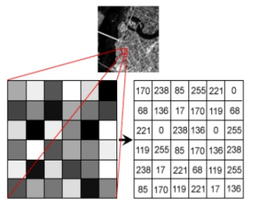
Image Representation
Is a matrix or grid of intensity values
integers [0, 255] or float points [0,1]
Each element in the matrix is a pixel
Can have 1 greyscale channel or multiple colour channels: RGB

Slide 11
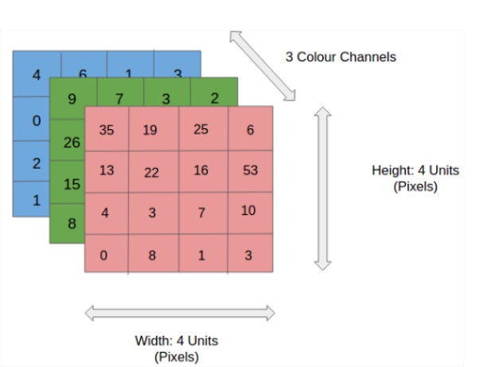
Image Representation
Is a matrix or grid of intensity values
integers [0, 255] or float points [0,1]
Each element in the matrix is a pixel
Can have 1 greyscale channel or multiple colour channels: RGB

Slide 12


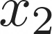
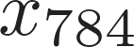
Correlated structures
...
...
...
...
Images are correlated spatially
Strong correlation between neighbouring pixels
Shifting an object will not alter its essence

Slide 13
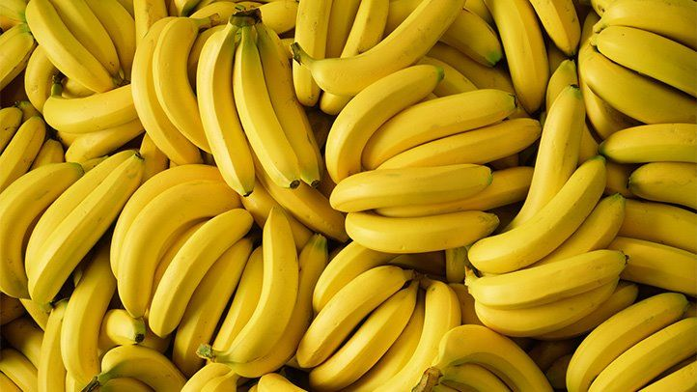
Correlated structures
...
...
...
...
Images are correlated spatially
Strong correlation between neighbouring pixels
Shifting an object will not alter its essence

Slide 14
Correlated structures
...
...
...
...
Images are correlated spatially
Strong correlation between neighbouring pixels
Shifting an object will not alter its essence

Slide 15
Correlated structures
...
...
...
...
Images are correlated spatially
Strong correlation between neighbouring pixels
Shifting an object will not alter its essence

Slide 16
Correlated structures
...
...
...
...
Images are correlated spatially
Strong correlation between neighbouring pixels
Shifting an object will not alter its essence

Slide 17
Correlated structures
...
...
...
...
Images are correlated spatially
Strong correlation between neighbouring pixels
Shifting an object will not alter its essence
Detect the features across an image and aggregate them
Form complete features higher up in the hierarchy

Slide 18
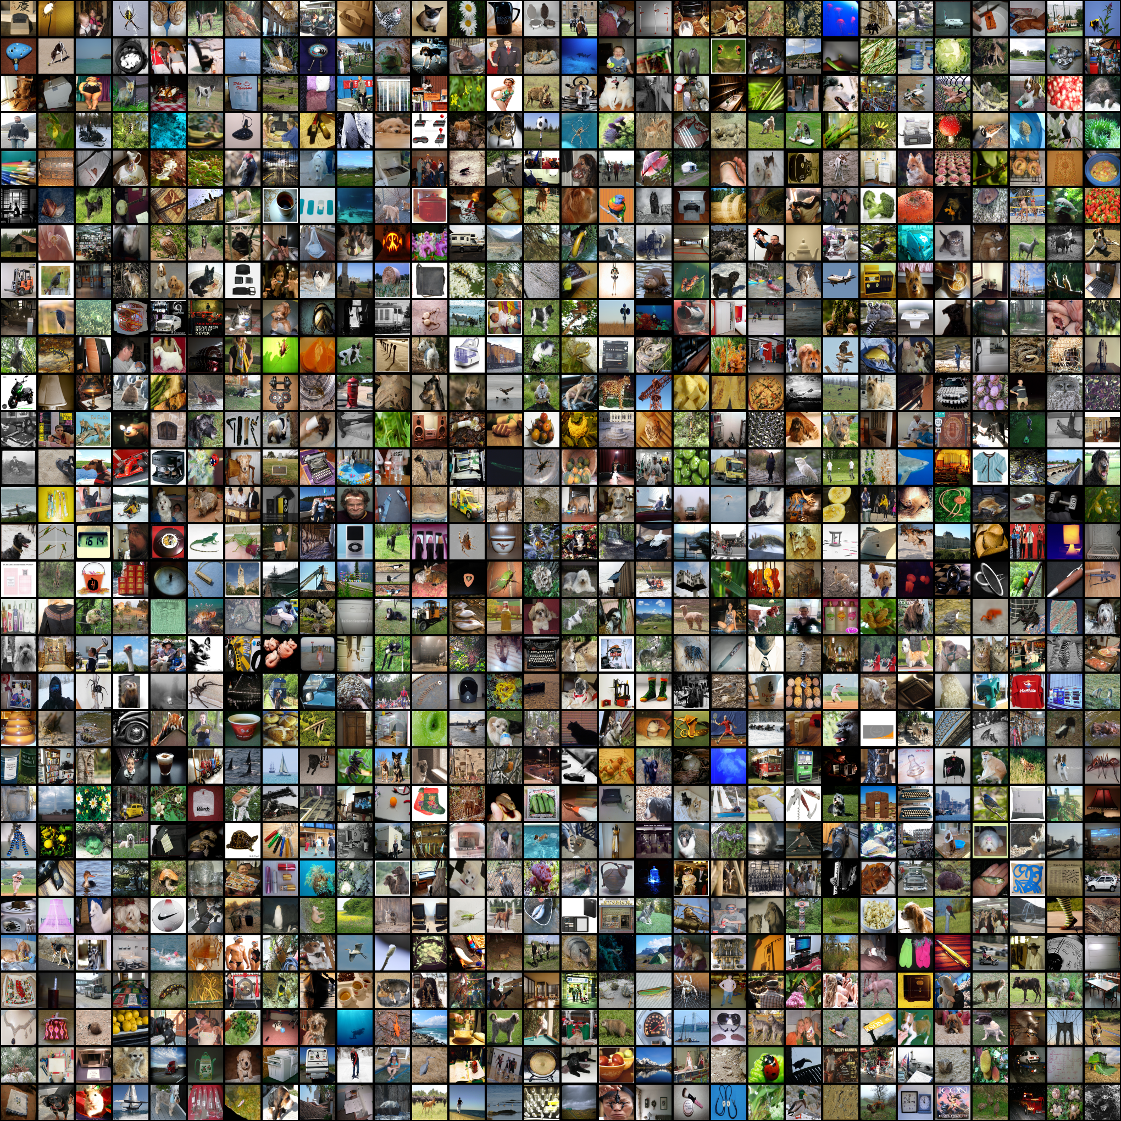

ImageNet Challenge
Computer Vision Benchmark 1.4M Images, 1000 classes
Image Classification Difficult until 2012

Slide 19
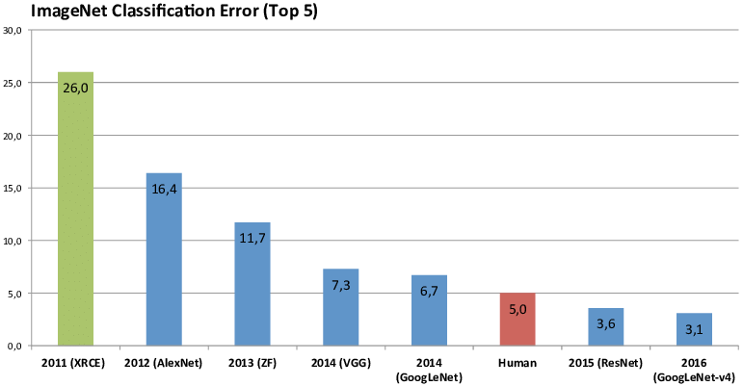
ImageNet Challenge
Computer Vision Benchmark 1.4M Images, 1000 classes
Image Classification Difficult until 2012

Slide 20
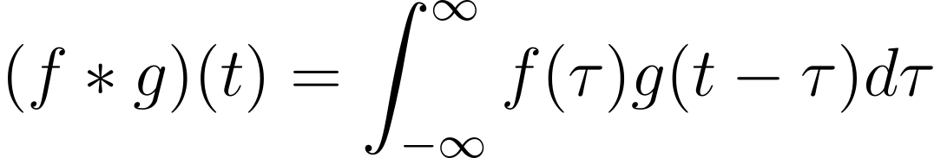
The Convolution Operation

Slide 21
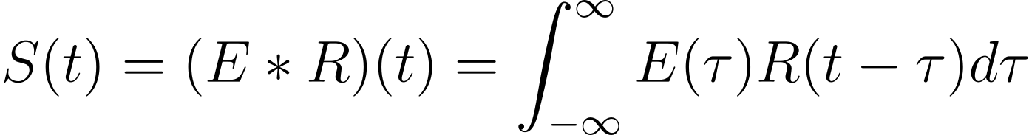
The Convolution Operation

Slide 22
The Convolution Operation
Impulse Response

Slide 23
The Convolution Operation
Source Signal
Impulse Response

Slide 24
The Convolution Operation
Seismogram
Source Signal
Impulse Response

Slide 25
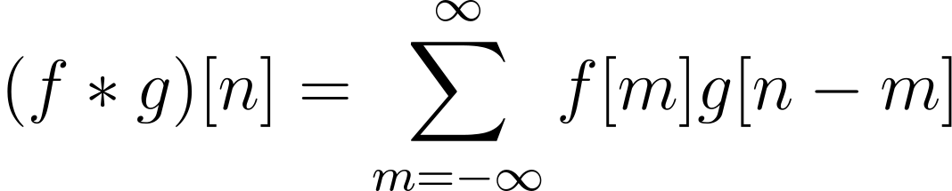
The Convolution Operation

Slide 26
The Convolution Operation
Initial signal gets modified by the system’s response
One signal slides across the other

Slide 27
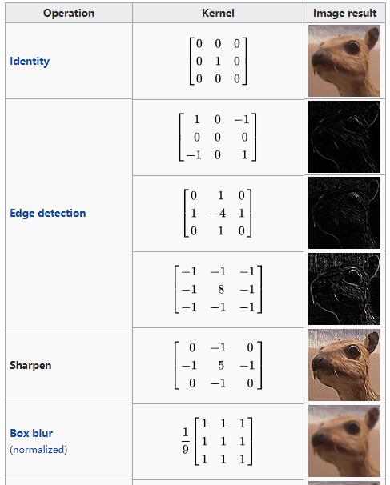
Convolutions
Kernel (filter): small matrix that we use to convolve an image

Slide 28
Convolutions
Kernel (filter): small matrix that we use to convolve an image
Convolution:
An operation that “blends” one function with another.

Slide 29

Convolutions
Kernel (filter): small matrix that we use to convolve an image
Convolution:
An operation that “blends” one function with another.
A filter applies a convolution operation on an image

Slide 30
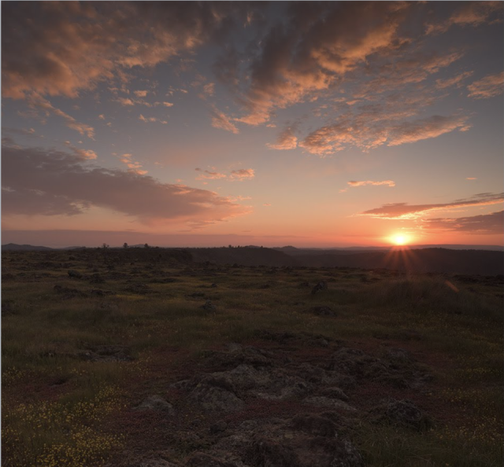

Convolutions
Kernel (filter): small matrix that we use to convolve an image
Convolution:
An operation that “blends” one function with another.
A filter applies a convolution operation on an image

Slide 31
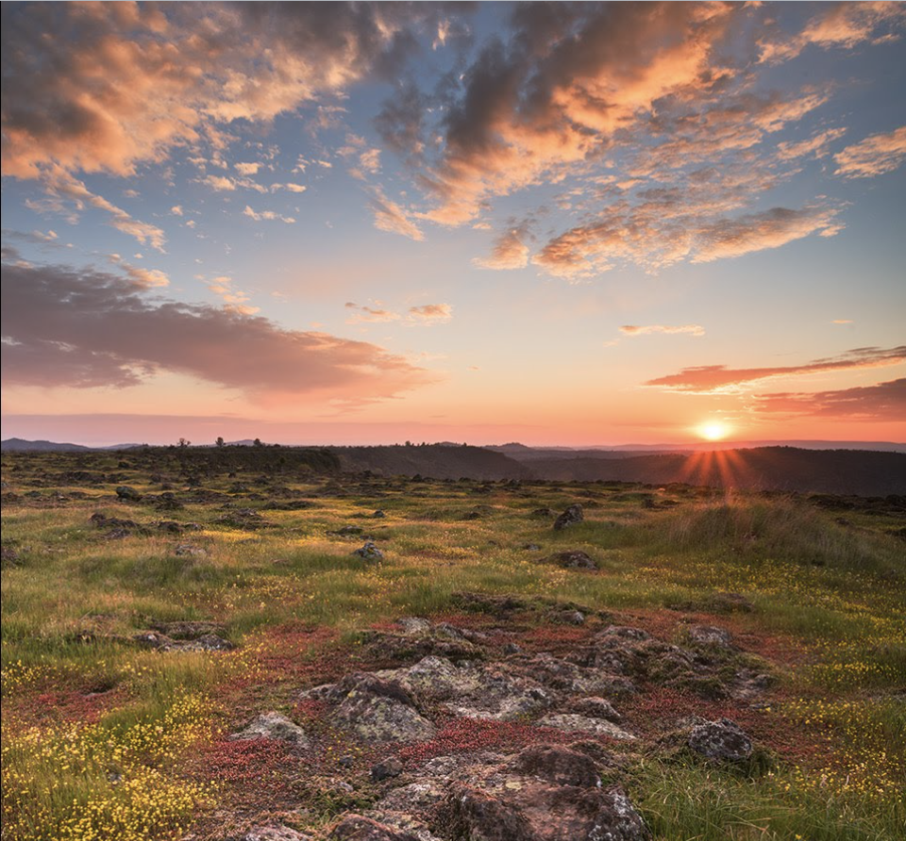
Convolutions
Kernel (filter): small matrix that we use to convolve an image
Convolution:
An operation that “blends” one function with another.
A filter applies a convolution operation on an image

Slide 32
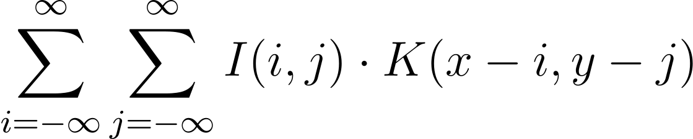
Convolutions
Kernel (filter): small matrix that we use to convolve an image
Convolution:
An operation that “blends” one function with another.
A filter applies a convolution operation on an image

Slide 33
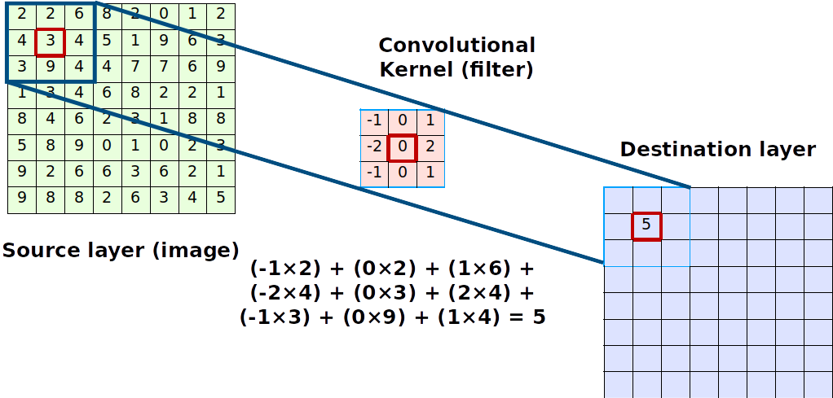
Convolutions Compute

Slide 34
Convolutions Compute
The kernel is shifted across the image and produces a point value
The step size in which it shifts is the stride
The output is always smaller, we use padding to preserve dimensions

Slide 35
Convolutions Compute
The kernel is shifted across the image and produces a point value
The step size in which it shifts is the stride
The output is always smaller, we use padding to preserve dimensions
The image shrinks according to
Output_size = inputSize -(KernelSize - 1)

Slide 36
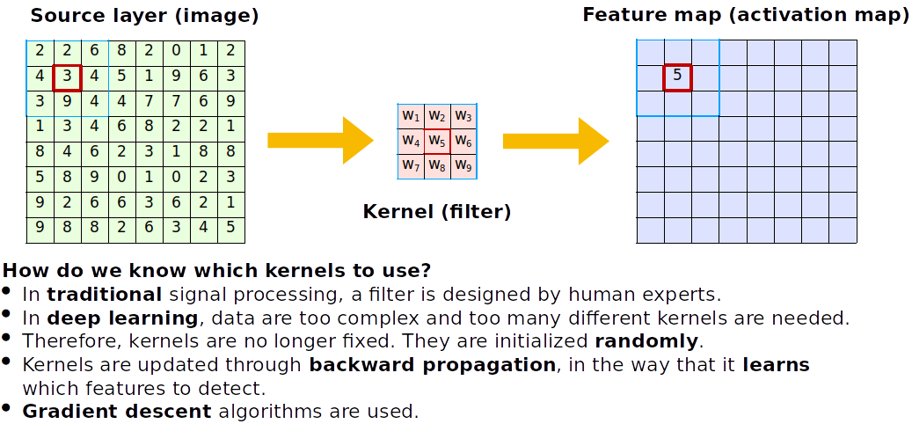
Convolutions

Slide 37
Convolutions
How do we know which kernels to use?
Kernels are learnt and initialized randomly
during training the CNN learns spatial features

Slide 38
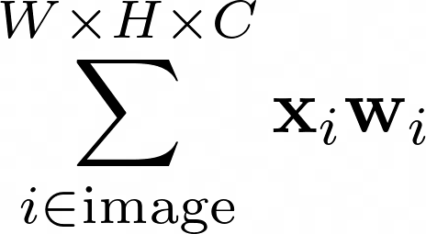
Convolutions
Fully connected
How do we know which kernels to use?
Kernels are learnt and initialized randomly
during training the CNN learns spatial features

Slide 39
Convolutions
Fully connected
How do we know which kernels to use?
Kernels are learnt and initialized randomly
during training the CNN learns spatial features

Slide 40
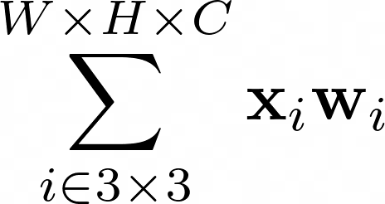
Convolutions
Fully connected
Locally connected
shared weights
How do we know which kernels to use?
Kernels are learnt and initialized randomly
during training the CNN learns spatial features

Slide 41
Convolutions
Fully connected
Locally connected
shared weights
How do we know which kernels to use?
Kernels are learnt and initialized randomly
during training the CNN learns spatial features

Slide 42
Convolutions
Fully connected
Locally connected
shared weights
How do we know which kernels to use?
Kernels are learnt and initialized randomly
during training the CNN learns spatial features

Slide 43
Convolutions
Fully connected
Locally connected
shared weights
How do we know which kernels to use?
Kernels are learnt and initialized randomly
during training the CNN learns spatial features

Slide 44
Convolutions
Fully connected
Locally connected
shared weights
How do we know which kernels to use?
Kernels are learnt and initialized randomly
during training the CNN learns spatial features

Slide 45
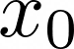
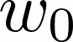
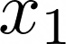
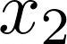
Anatomy of an Convolutional Neural Network
CNNs actually look a lot like normal Dense Neural Networks
Interpretation: Every node is a kernel

Slide 46
Anatomy of an Convolutional Neural Network
See the nodes as moving across the image!
We say these are shared weights
CNNs actually look a lot like normal Dense Neural Networks
Interpretation: Every node is a kernel

Slide 47
Anatomy of an Convolutional Neural Network
Fully connected
Locally connected
shared weights
See the nodes as moving across the image!
We say these are shared weights
CNNs actually look a lot like normal Dense Neural Networks
Interpretation: Every node is a kernel

Slide 48
Anatomy of an Convolutional Neural Network
Fully connected
Locally connected
shared weights
See the nodes as moving across the image!
We say these are shared weights
CNNs actually look a lot like normal Dense Neural Networks
Interpretation: Every node is a kernel

Slide 49

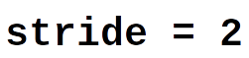
Pooling and dilated convolutions
We could discard information gradually by max pooling
Keep the strongest signal, works better than average pooling
Nowadays, we use a bigger stride for dimensionality reduction

Slide 50

Pooling and dilated convolutions
We could discard information gradually by max pooling
Keep the strongest signal, works better than average pooling
Nowadays, we use a bigger stride for dimensionality reduction
Dilated convolutions can be used if you expect your images to have information which are spatially far from each other

Slide 51
11/01/2023
CNN Cases
High Performance Machine Learning Group

Slide 52
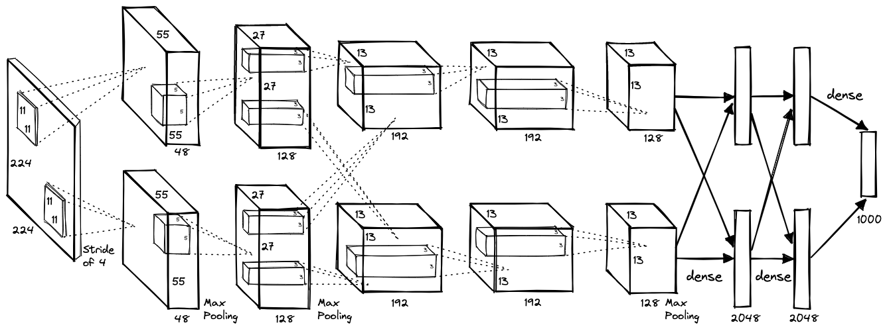
AlexNet (2012)

Slide 53
AlexNet (2012)
Images become smaller and number of filters increases as we go deeper
8 layers with dropout and ReLU activations trained for 6 days on 2 GPUs

Slide 54
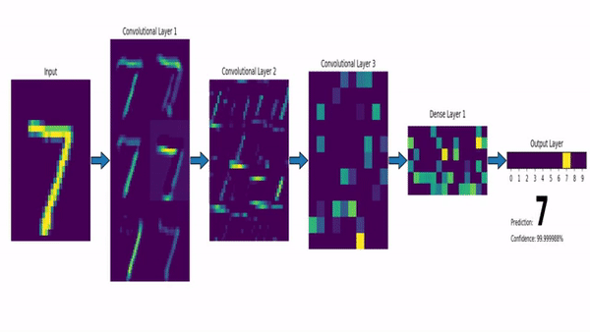
CNN with a Dense Layer output
https://www.louisbouchard.ai/densenet-explained/

Slide 55
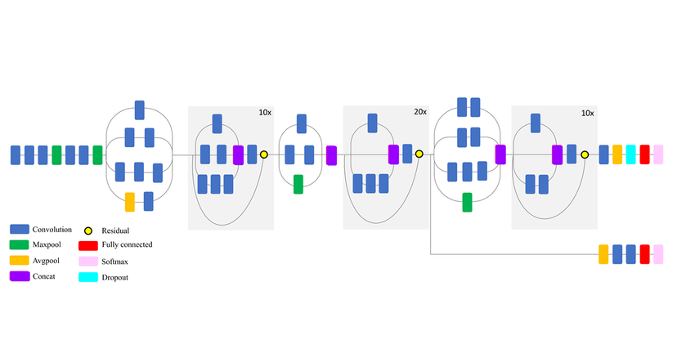
Transfer Learning

Slide 56
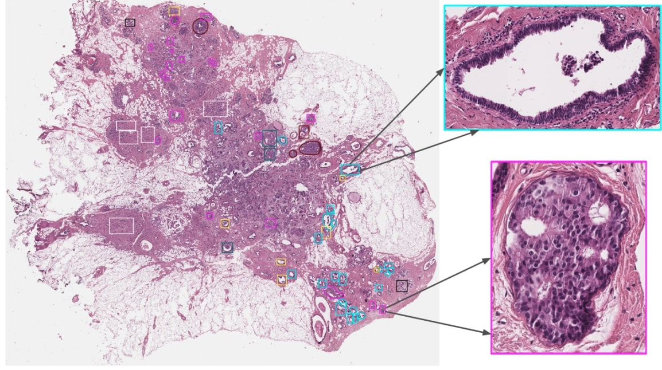
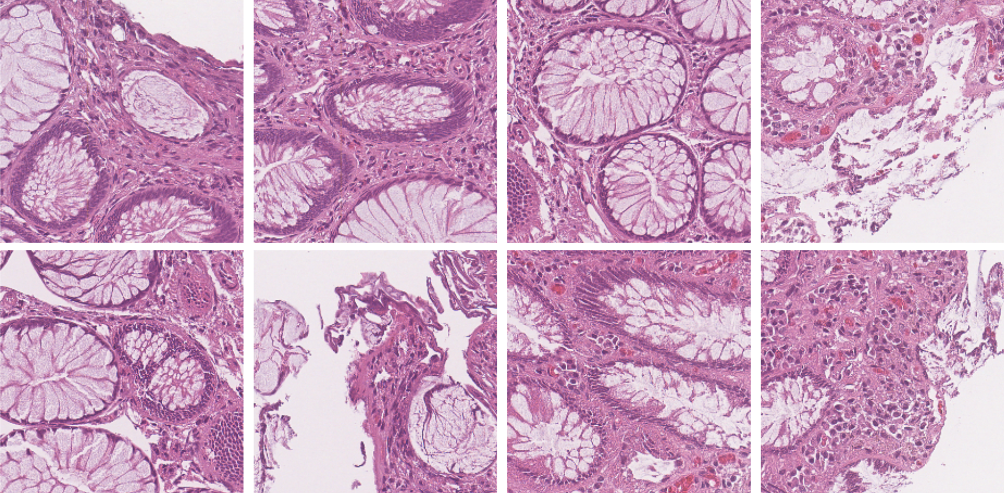
Transfer Learning

Slide 57

VGG16 and ResNet (2014, 2015)
VGG16: construct large and deep models (120M params)
Vanishing gradient problem

Slide 58
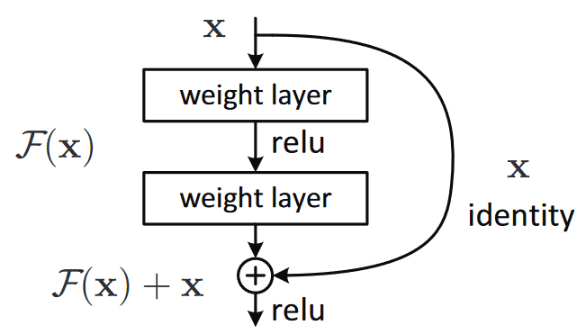
VGG16 and ResNet (2014, 2015)
VGG16: construct large and deep models (120M params)
Vanishing gradient problem

Slide 59
ResNet (2015)

Slide 60
ResNet (2015)
ResNets: construct large and deep models with skip connections, able to train up to 152 layers (!)
Higher abstraction and less nuisance from vanishing or exploding gradients

Slide 61
ResNet (2015)
ResNets: construct large and deep models with skip connections, able to train up to 152 layers (!)
Higher abstraction and less nuisance from vanishing or exploding gradients
Early layers learn features that get progressively more abstract, we can preserve and control the flow of information with skip connections

Slide 62
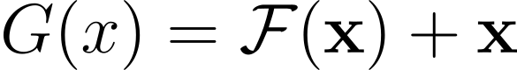
ResNet (2015)

Slide 63
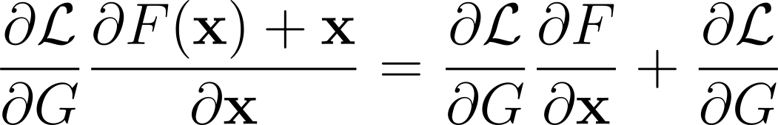
ResNet (2015)

Slide 64
ResNet (2015)

Slide 65
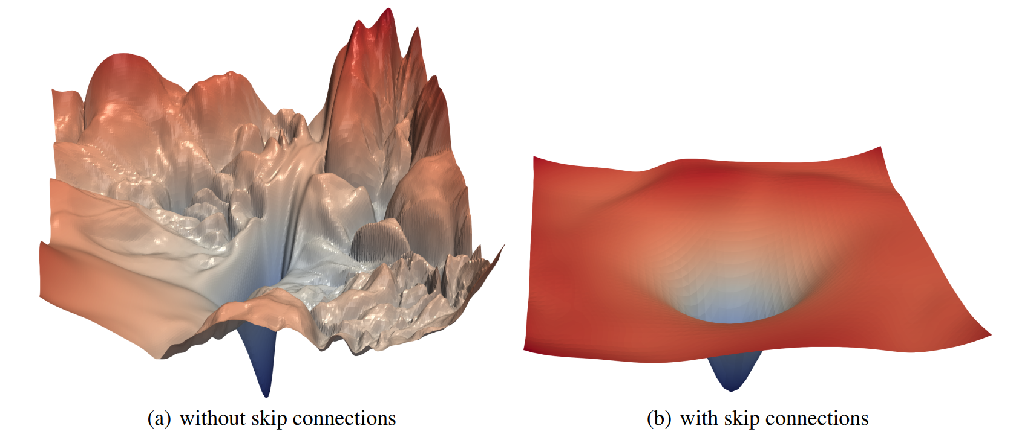
Li, H., Xu, Z., Taylor, G., & Goldstein, T. (2017). Visualizing the Loss Landscape of Neural Nets. NIPS
ResNet (2015)

Slide 66
09/11/2022
Thank You
High Performance Machine Learning Group

Slide 67
09/11/2022
Slides Graveyard
High Performance Machine Learning Group

Slide 68
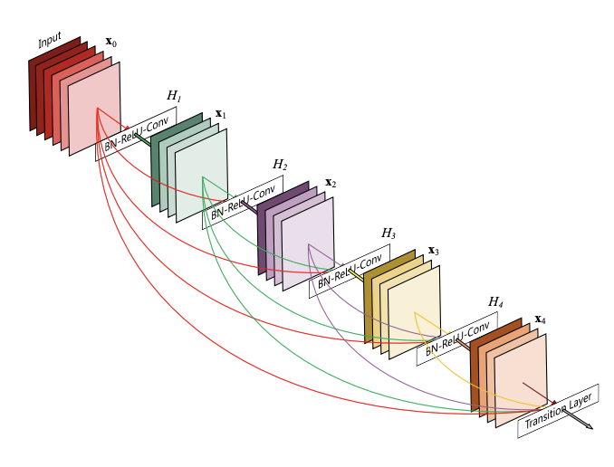
DenseNet (2016)
ResNets: construct large and deep models with skip connections, able to train up to 152 layers (!)
Higher abstraction and less nuisance from vanishing or exploding gradients
Early layers learn features that get progressively more abstract, we can preserve and control the flow of information with skip connections

Slide 69
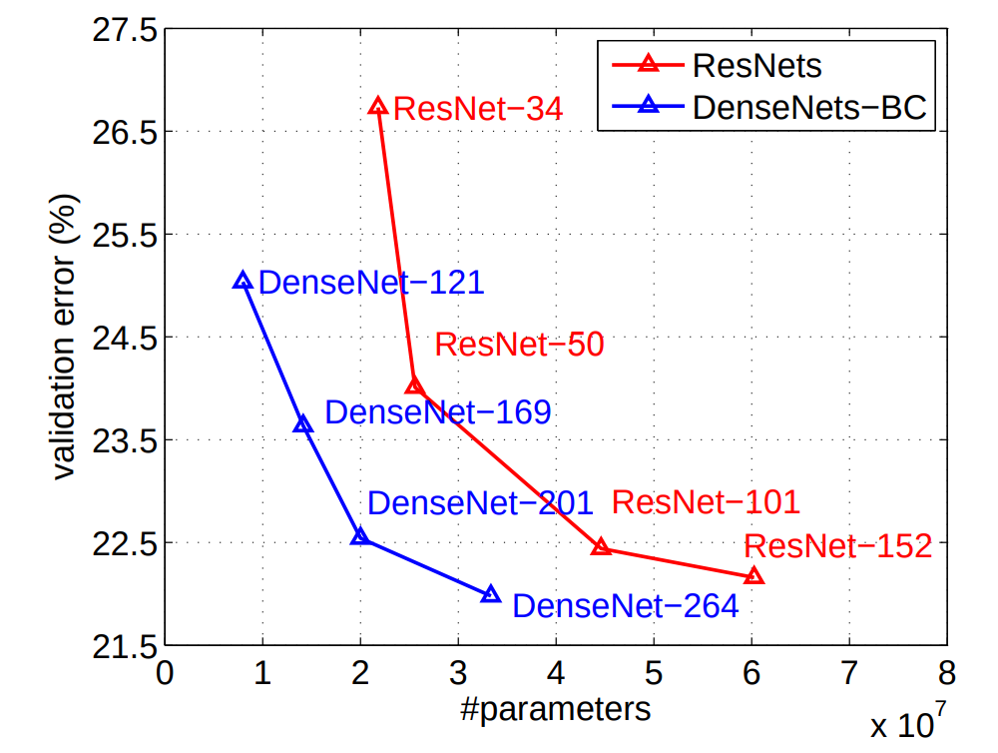
DenseNet (2016)
ResNets: construct large and deep models with skip connections, able to train up to 152 layers (!)
Higher abstraction and less nuisance from vanishing or exploding gradients
Early layers learn features that get progressively more abstract, we can preserve and control the flow of information with skip connections

Slide 70
